Slide 1
WP PowerHour:
Ally for Websites
SUSAN BLAIR
Web Development Specialist
Information Technology Services,
University of Tennessee Institute of Agriculture

Slide 2
Housekeeping
As I show Ally for Websites and how to make corrections to your assigned website(s), please post your questions in the chat and I will answer them at the end of the demo.

Slide 3
Today’s Agenda

Slide 4
Do I Have Access to Ally?
Access to Ally was assigned in October 2023
Content managers already have access
Are you in an Extension county office? Check with your regional IT trainer to see if you have access

Slide 5
An Update on the Accessibility Front
The Department of Justice signed a final rule as it relates to web accessibility, digital documents (PDF, Word, Excel, PowerPoint) and accessibility of social media feeds on April 8, 2024.
The final rule was published on April 24, 2024, which means that as of April 24, 2026, UTIA’s websites, digital documents and social media feeds must be accessible to everyone.
  The final rule focuses on new content that is added to websites as of April 24, 2026.

Slide 6
Knowledgebase Articles
These are found in the UTIA WordPress Guide:
  Ally for Websites page: https://utiawpguide.tennessee.edu/ally-for-websites/
    Topics
      Logging into Ally
      Common Accessibility Errors:
        Page has common accessibility errors in Ally for Websites and how to fix them with the suggested fix for each type of error.
        Ally does a great job of stepping through and explaining how to fix the errors for the pages that are in their documentation.
The 2024 Annual Accessibility Training goes over how to fix the common accessibility errors. The resources from the training can be found at: https://utiawpguide.tennessee.edu/2024-annual-accessibility-training-resources/

Slide 7
Learn how to correct accessibility errors
I created a page that has all the common accessibility issues that Ally for Websites detects including:
  Alt text for images
  Broken links
  Heading order
  Empty heading
  The above are errors that can be fixed easily and quickly. Note that the changes that you make will not update in the Ally report until the next crawl. We currently have weekly crawls that happens on Saturday mornings.

Slide 8
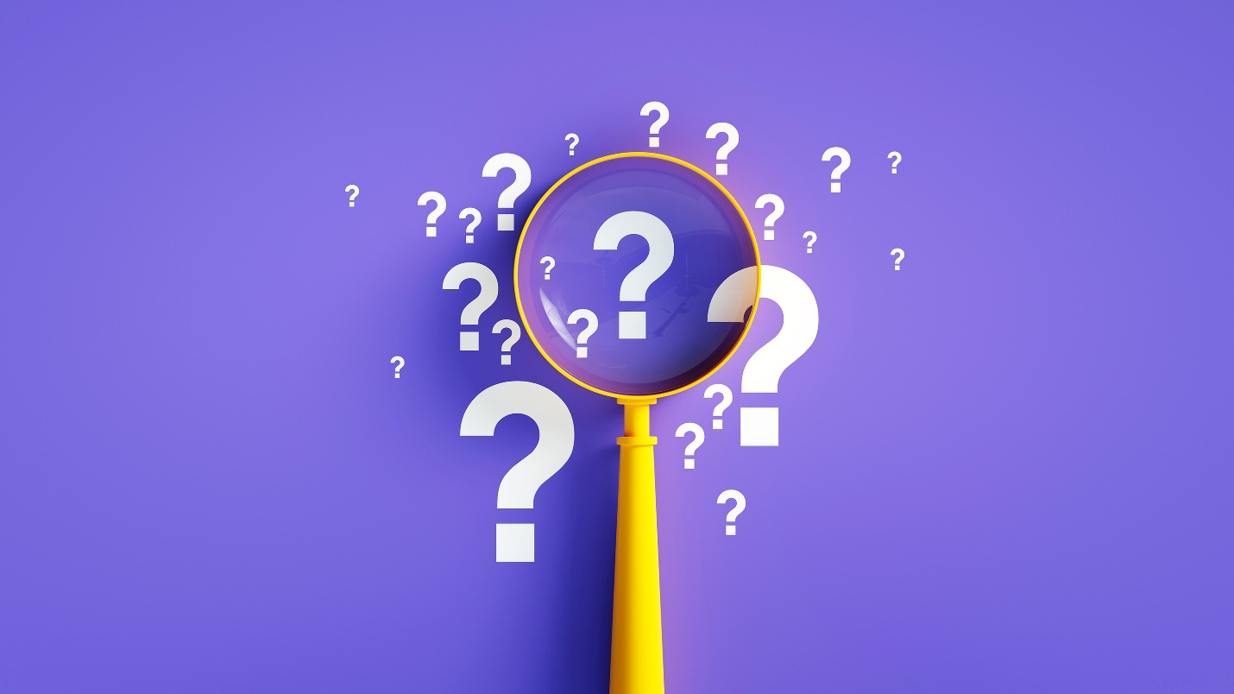
Questions?
I’m available to answer questions on accessibility!
susan.blair@utk.edu

Slide 9
Thank You!

